Slide 1
Docker Compose

Slide 2
Outline
Objectives
On completing this module, you will be able to:
Understand the need of container management in the context of microservices architecture
Use Docker Compose to manage multiple containers
Topics
Docker Compose

Slide 3
Example: Microservice Interaction Diagram – Browse books
Book
1. Get all books
2. Return a list of books
Amazing Bookstore UI
Browse books
Legend
Micro-service
External service

Slide 4


Example: Microservice Interaction Diagram – Place an order
5. Send the newly created order
{ order }
Shipping Record
Order
2. Send the order information
{cart items}
3. Return the newly created order
{ order }
6. Return the created shipping record or error
Place an Order
Activity Log
4. Send the order activity for recording
1. Send the order information
{cart items}
7. Return the created order and shipping record and/or error
3. or 6. If error from any service, activate the error handler
Error
Amazing Bookstore UI
Place an order
Producer/sender of request data
Consumer/receiver of request data
Notes:
Qs: in order to build and start running all of containers for the microservices,
* how many command prompt windows we need to open, and how many docker and python commands (e.g., “docker build”, “docker run”, "python book.py") we need to run?
* how many commands (e.g., “docker stop”, “docker rm”) we need to run to turn off/remove all the microservices?
So, better automation is needed to manage the builds/runs/executions of the containers for microservices.

Slide 5
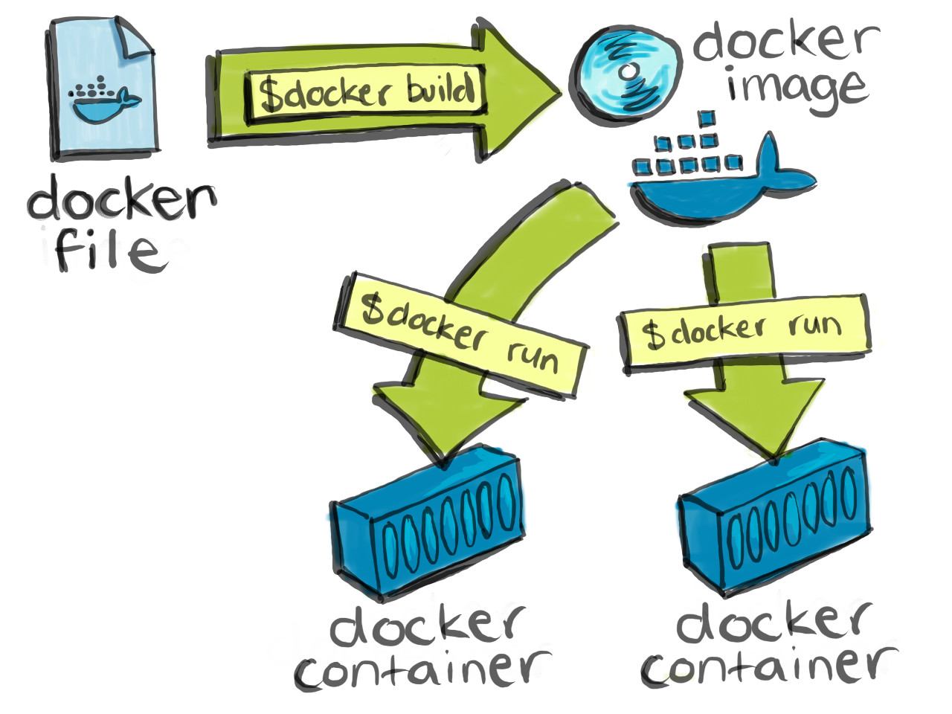
Docker Containerization Process
Better Automation?
Microservice code: book.py
Python and needed modules
Right DB settings
…
Dockerfile contains the instructions for Docker to build an image (FROM, COPY, RUN, etc.)
Source: https://cultivatehq.com/posts/docker/
Notes:
For easier deployment, each microservice is containerization. The builds/runs/executions of microservices are via docker commands.
So, a better automation of the containerization process of all microservices should be able to deal with images and containers.

Slide 6


Running the Book Microservice in Multiple Containers
docker run -p 6000:5000 -e <url_to_db@host.docker.internal:3306/book> <image name>
docker run -p 6100:5000 -e <url_to_db@host.docker.internal:3306/book> <image name>
……
Better Automation?
http://localhost:6000
container 1
container 2
Images
172.17.0.2
172.17.0.3
book.py
http://localhost:6100
Book
Book
CMD
docker build
docker pull
docker run
docker rm
…
Docker Client
libs
Book DB
Libs
Libs
Client (e.g., a Web browser)
MySQL
Docker Engine
mapping localhost:6000 to 172.17.0.2:5000
mapping localhost:6100 to 172.17.0.3:5000
……
WampServer
Docker Host
(e.g., a Windows OS)
Notes:
Questions to consider:
- Will there be too many containers to manage?
- For clients/service consumers, will there be too many URLs to remember, in order to invoke various instances of the microservices?
We can use a container management tool, such as Docker Compose, together with API gateway/load balancer, to help alleviate the management problems.
Beyond the course scope:
There are many other tools available for alleviating the container/service management problems from different aspects, e.g., NGINX, Kubernetes (k8s, https://kubernetes.io/) cf. https://www.nginx.com/blog/reduce-complexity-with-production-grade-kubernetes/ https://www.nginx.com/blog/how-do-i-choose-api-gateway-vs-ingress-controller-vs-service-mesh/

Slide 7
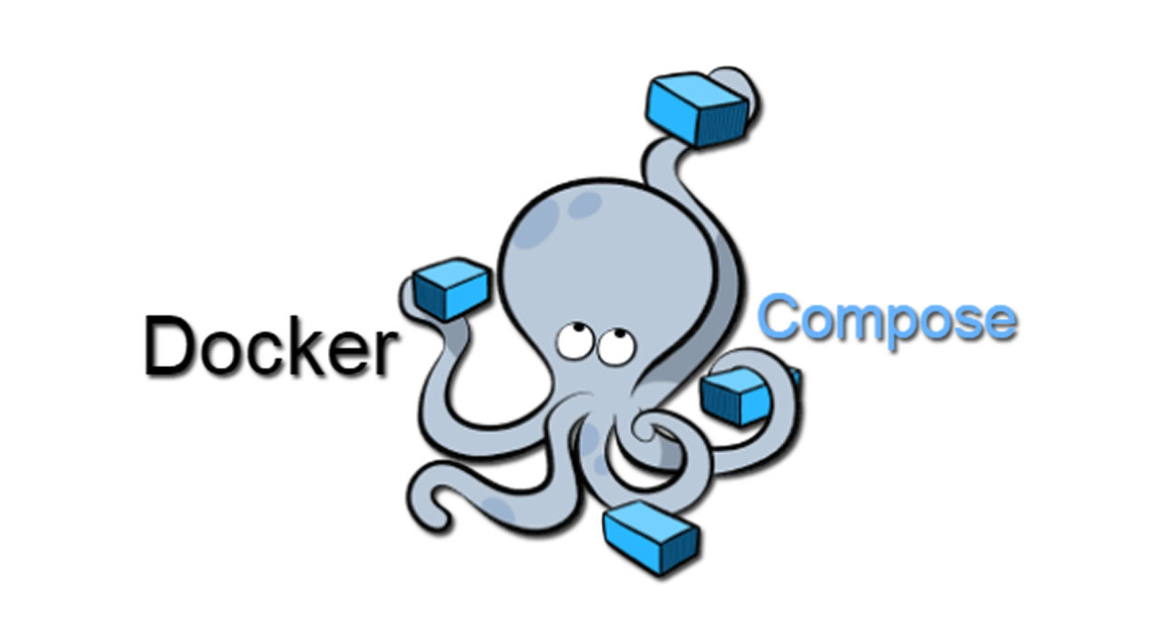

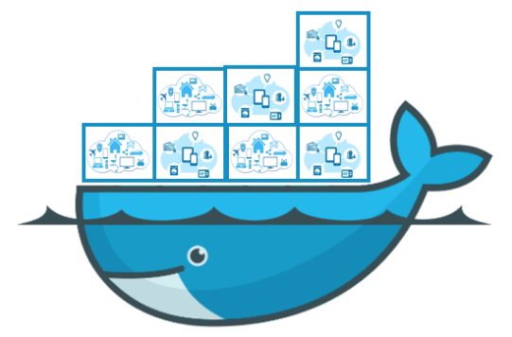
Docker Compose
A tool for defining and running multi-containers
Use YAML files to define the configurations of containers
Use docker-compose (or docker compose) command to run containers and related operations according to the configurations in a YAML file
Notes:
Image source: https://i.morioh.com/2020/01/18/1d54fa053d39.jpg

Slide 8
YAML
Yet Another Markup Language
A.k.a., YAML Ain't Markup Language
The file suffix is usually .yml or .yaml
Often used to describe software configurations in a human-readable way
Use [...] for lists/arrays and {...} for name-value maps/dictionaries.
Can be considered as a superset of JSON
Use various compact syntax for describing data
E.g., use Python-style indentation to indicate nesting
E.g., use a leading hyphen ( - ) to indicate a list element
E.g., use a line to separate array/map elements from each other
Notes:
The YAML syntaxes are beyond the quiz/exam scope, but within the course project scope as the project will require you to use yaml for docker compose.
Cf. https://en.wikipedia.org/wiki/YAML

Slide 9
Sample YAML for Docker Compose
version: "3.8" # The version of the compose file format; no longer necessary in v3.0 and later
services:
book: # The name to be used in compose files for referring to the book microservice
build: # The build configuration for the book microservice
context: ./
dockerfile: Dockerfile
image: eklum/book:1.0
container_name: book
ports:
- "5000:5000"
environment:
- dbURL=mysql+mysqlconnector://is213@host.docker.internal:3306/book
# dbURL: mysql+mysqlconnector://is213@host.docker.internal:3306/book
# The above two lines have the same effect.
restart: always
networks:
- bookstore-net
depends_on:
- dbms
dbms: # the database management software
image: mysql:9.2.0
container_name: bookstore-dbms
ports:
- "3306:3306"
networks:
- bookstore-net
volumes:
- bookstore-volume:/var/lib/mysql
environment:
……
networks: # the networks to be used by the services
bookstore-net: # name of the network to be referenced
name: bookstore-testnet # Actual name of the network
driver: bridge
volumes: # the persistent storages to be used
bookstore-volume: # name of the volume to be referenced
name: bookstore-data # Actual name of the volume
Notes:
A yaml file specifies:
Which containers to run (services).
Networking configurations (how they communicate).
Volumes (persistent storage).
Environment variables for each service.

Slide 10
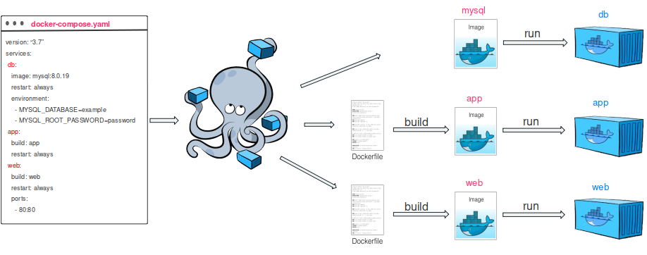
Using Docker Compose
A common procedure
Define a Dockerfile for each image to be built
Define needed services in a YMAL configuration file (docker-compose.yml or compose.yaml)
Run docker compose up (or other suitable options)
Notes:
The docker compose command can specify which YAML configuration file to use by using -f option; e.g., docker compose –f any_yaml_file_name up
Image source: https://www.docker.com/blog/containerized-python-development-part-2/

